Slide 1












Strategy Update Session
StrongPoint
www.strongpoint.com
**************************************************
**************************************************
Thank you for shopping with StrongPoint
25 April 2024

Slide 2

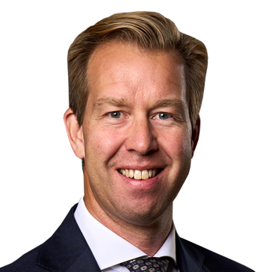


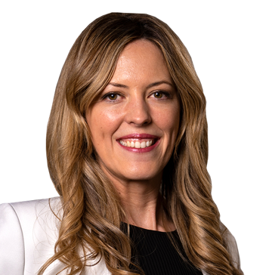
Agenda
& Speakers
About StrongPoint
Update on financial results vs. ambitions
Big wins from big investments
Deep dive on Scandinavia, UK and Spain
Financial update
Concluding comments
Q&A
Jacob Tveraabak
Marius Drefvelin
Chief Executive Officer
Chief Financial Officer
Magnus Rosen
Alex Eveleigh
Lorena Gomez
MD & SVP Norway & Sweden
MD & SVP UK & Ireland
MD & SVP Spain

Slide 3
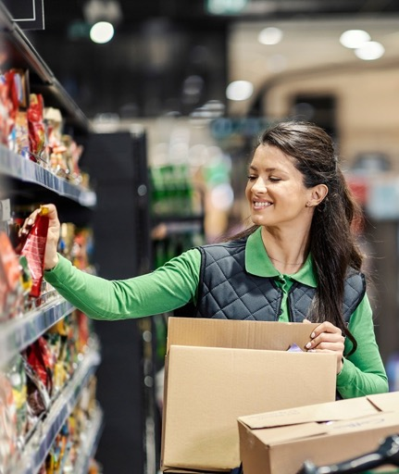





Our purpose:
Impact on grocery retailers
Impact on end consumers
"Retail technology
in every shopping experience for
a smarter and
better life"
Driving
efficiency
savings
Improving both
the in-store and online experience for shoppers
Boosting margins

Slide 4










StrongPoint at a glance
Years in business
39
Revenue from grocery retailers
>80%
Countries with offices and full sales, service and support coverage
Countries with
full sales, service and support
9
NOK annual revenue
1.35Bn
Kr
No. of employees
500+
Listed on Oslo
Stock Exchange
since
2003
Countries covered with partners
20
GRI reporting & member of UN Global Compact
2021

Slide 5
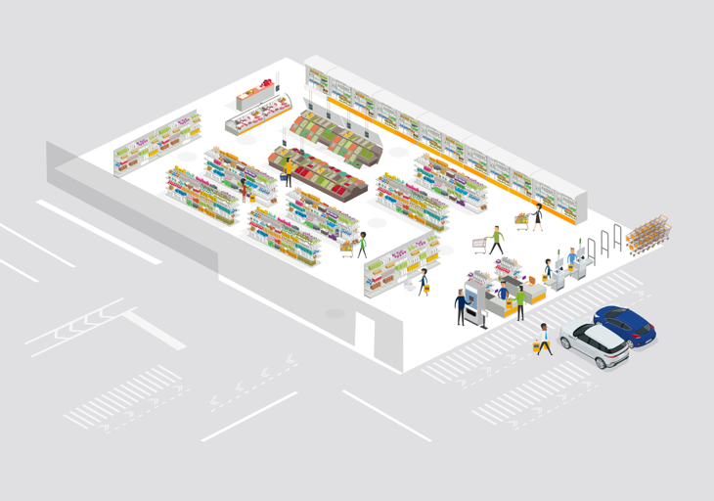
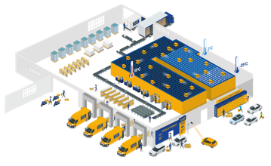






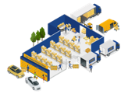











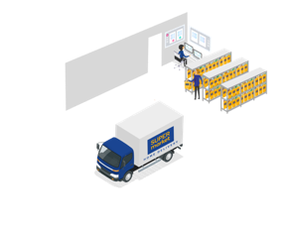


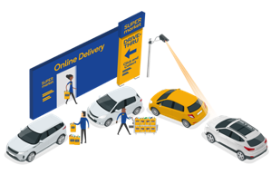






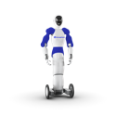

Our grocery retail solutions - aisle to aisle & door to door
In-store
E-Commerce
1
In-store
Product Pickup (Vensafe)
9
In-store Manual Picking
16
11
2
10
Dark Store Manual Picking
Electronic Shelf Labels
6
2
9
3
Self-Checkout
& AI solutions
11
Automated Fulfilment
12
10
4
12
8
Cash
Management
Grocery Lockers
5
7
5
ShopFlow Logistics
13
1
Home
Delivery
3
14
4
6
14
In-store
Pickup
13
Scales
7
Autonomous Mobile Robots
15
Drive-thru
Pickup
15
8
Humanoid Grocery Robot
16
Warehouse
Management
System

Slide 6


















Solution portfolio well suited for grocery retailers in core markets
Sales
Service
Installation
Support

Slide 7
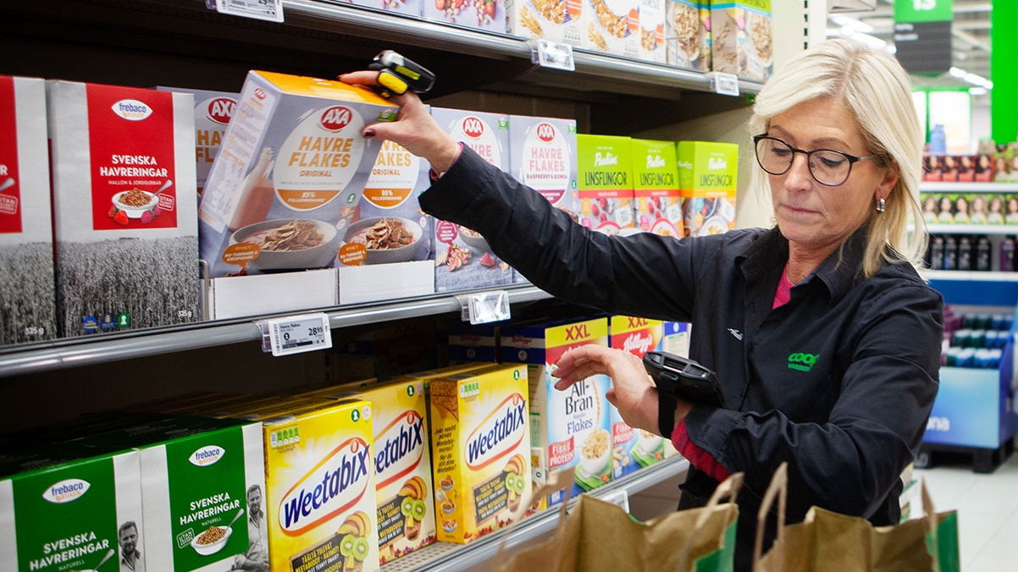

Update on financial results vs. ambitions

Slide 8


What we in 2020 communicated as our 2025 financial ambitions
2.5Bn
Revenue
NOK
13-15%
EBITDA
Notes:
We ended at NOK 1.5 bn in 2023, far behind the anticipated 2023. A growth from 1.5 to 2.5 would entail a xx% CAGR, which is not realistic – in particular not in today’s business sentiment
Our EBITDA-% was half of our ambitions. Clearly, incorporated in last year’s figure was the investments in E-com and Spain – significant EBITDA-drags, however we also started observing that our traditional base of business, the one yielding 10-11% EBITDA year in and year out was cracking. …

Slide 9
Where we are today and our 2025 estimates
2023 Results
2025 Estimate
1.35Bn
1.5-1.8Bn
Revenue
NOK
NOK
0%
4-6%
EBITDA
Notes:
As of now, with the current large uncertainty in the market segment, we estimate to be arriving at a revenue between 1.5 and 1.8 bn
EBITDA..
These are estimates, clearly not ambitions or the level we want to be at – however, we’ll get back to this
Now, many of you will have 2 Qs:
1. Why did you wait so long to announce that the 2025 ambition would not be met?
2. How is it possible to miss so badly on the ambition set?
I’ll try to explain that on the next few slides

Slide 10
Why did we hold onto ambitions for so long?
Revenue
MNOK
-18%
-15%
Q4 20
Q1 21
Q2 21
Q3 21
Q4 21
Q1 22
Q2 22
Q3 22
Q4 22
Q1 23
Q2 23
Q3 23
Q4 23

Slide 11
Business developed far weaker than anticipated
Revenue 2023 MNOK
EBITDA 2023 MNOK
-109
MNOK
All markets significantly weaker than anticipated in Q4 except
Baltics
-46
MNOK
2023 Estimate as of Q3
2023 Actual
2023 Estimate as of Q3
2023 Actual
* EBITDA shown for 2023 is excluding 21 MNOK in non-recurring items
.

Slide 12



Three major challenges in 2023 and continuing into 2024
Challenge 1:
Difficult market for grocery retail and retail technology
Challenge 2:
Currency depreciation in Norway and Sweden against EUR and USD
Challenge 3:
Specific challenges in UK business unit

Slide 13
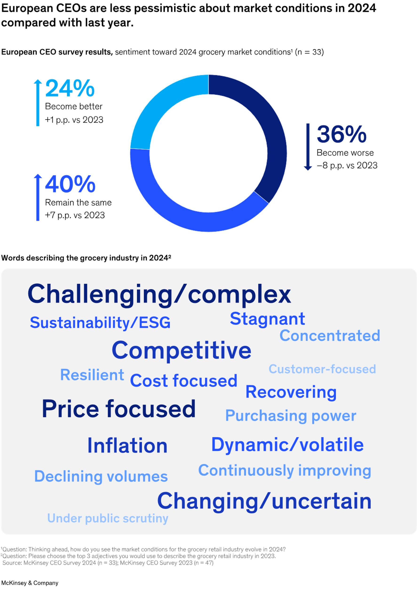






Challenge 1:
A difficult time for grocery retail
Top 15 trends mentioned by CEOs
for the grocery industry 2024*
Top 1 - 3
Top 4 - 7
CEOs about the grocery industry 2024*
Cost & margin pressure
Disposable household income under pressure…
…leading to more
discounter growth…
…pushes supermarkets and high-end grocery retailers to invest more in price than in technology
The profitability of
grocers declined
further in 2023, and
the pressure will not
go away in 2024.*
*McKinsey report, The State of Grocery Retail Europe, published April 2024
.
https://www.mckinsey.com/industries/retail/our-insights/state-of-grocery-europe-2024-signs-of-hope#
Notes:
Pressure on disposable househould income, leading to growth of discounters, which then pushes supermarkets and high-end grocery retailers to invest more in price than technology
With higher interest rate the attractiveness of any investment – all things equal – is diminished. With interest rates going from very low and close to zero, to 4-5%, the shock has certainly been dampening the investment willingness from some retailers

Slide 14
Challenge 2:
NOK and SEK depreciating against EUR and USD
Development of currency exchange rates indexed to average monthly rates December 2021
115
110
105
12-18%
100
depreciation since start of 2022
95
90
NOK/EUR
SEK/EUR
85
NOK/USD
80
SEK/USD
75
Jan
Mar
May
Jul
Sep
Nov
Jan
Mar
May
Jul
Sep
Nov
Jan
Mar
2022
2023
2024

Slide 15

Challenge 3:
UK business specific challenges
Overview
>
H2 2023
Q1 - 2024
M&A is part of long-term strategy
ALS business: great team and outstanding customer service reputation
Important contributor in winning Sainsbury’s
Replacement of UK executive management initiated
New MD and SVP with significant grocery retail and technology experience appointed
As result of changes, are experiencing short-term negative repercussions in shopfitting business

Slide 16
Challenges summarized – now, what actions?
Challenge 1:
Difficult market for grocery retail and retail technology
Challenge 2:
Currency depreciation in Norway and Sweden against EUR and USD
Challenge 3:
Specific challenges in UK business unit

Slide 17

Actions taken in Scandinavia and Baltics
Transformational actions in our traditional markets:
Immediate cost reduction, reorganisation and commercial actions taken following signs of challenges:
25 MNOK gross cost reduction announced in Q4 2023 with full effect from January 1, 2024
Additionally, 20 MNOK gross cost reduction following Q1 2024 with full effect from July 1, 2024
Reorganization of Norway and Sweden with teams under one MD & SVP, Magnus Rosén

Slide 18
Actions taken in UK and Spain
Further investments in key markets of UK and Spain to leverage recent large customer successes
Recruitments and reorganization:
Alex Eveleigh, former Aldi, Ocado, ASDA and Takeoff Technologies executive, as new MD SVP for UK and Ireland
Strengthening UK and Spain teams to capitalise on Sainsbury’s and Mercadona projects
Neil McCourt, former Tesco Retail MD and Amazon Director, as new strategic advisor
Reorganization of product team to support customer opportunities in UK and Spain

Slide 19
Continuing to develop strong base of recurring and re-occuring revenue
2023 Revenue
Recurring revenue
New sales
We are still to a large extent a project driven company.
Focus going forward is to grow recurring and re-occuring base of revenue, in particular for new
large-scale customer projects
Re-occurring
revenue

Slide 20
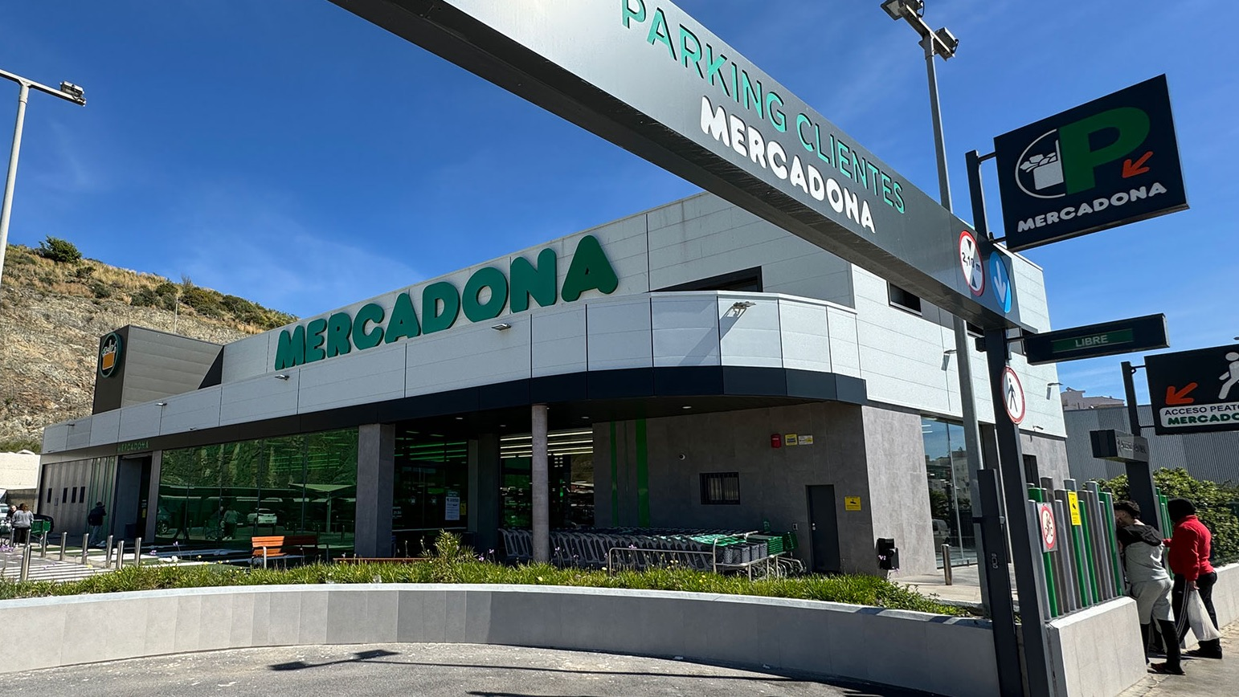

Big wins from big investments

Slide 21




Our investments are bearing fruit
Exporting our world-class Order Picking solution to the UK driving essential efficiency savings
Developed new cash management solution with Mercadona to improve efficiency of cash operations

Slide 22



Contextualising the size of these grocery retailers
2023 Revenue
NOK 110Bn
NOK 400Bn
NOK 410Bn
Notes:
Three reaons why our projects with these two grocery retailers is so important (each point on the next three slides)
The sheer size of the project opportunities in themselves
The upsell opportunities – bearing in mind we’ve sold on average 4.7 solutions to our top 10 grocery retailers that we’ve had a long-standing relationship with
The authority that these major grocery retailers command in their home markets (and beyond) creates natural interest from other, significant retailers

Slide 23



Value in project opportunities are very large in themselves
NOK 60Bn
E-commerce revenue
NOK 140Bn
Cash transactions value

Slide 24
As an incumbent we are well placed to upsell additional solutions
4.7
average number
of solutions
used
Recent clients currently using 1 and 2 solutions respectively
Number of solutions being used by largest 10 grocery customers in Norway, Sweden and Baltics
2
1
Coop EE
IKI
Lietuva
Maxima
Rema1000/
Reitan
Norges
Gruppen
Coop Norway
ICA-Gruppen
RIMI
Coop Sweden
Axfood

Slide 25


Large serviceable customer base of grocery retailers
UK grocery retailer market percentage share, by retailer*
Spanish grocery retailer market percentage share, by retailer*
26.4
26.2
14.3
9.9
13.4
6.4
9.5
9.5
4.4
6.6
4.1
5.3
3.4
4.1
3.1
3.2
2.3
1.5
*Source: Kantar, IGD
.

Slide 26
Large opportunities in key markets
Market size
(BnNOK)*
StrongPoint grocery chain coverage
StrongPoint solution penetration
Examples of opportunities
Country
270
100%
Self-checkout, Vensafe, E-Commerce
Norway
Traditional markets
E-Commerce, Electronic
Shelf Labels, Self-Checkout
Sweden
300
100%
Baltics
& Finland
130
Vensafe, Self-Checkout, Electronic Shelf Labels
90%
Spain
1,230
Cash Management,
Self-Checkout, E-Commerce
Future key markets
UK
& Ireland
2,650
E-Commerce, Electronic Shelf Labels, Vensafe, Self-Checkout
*Source: IGD

Slide 27
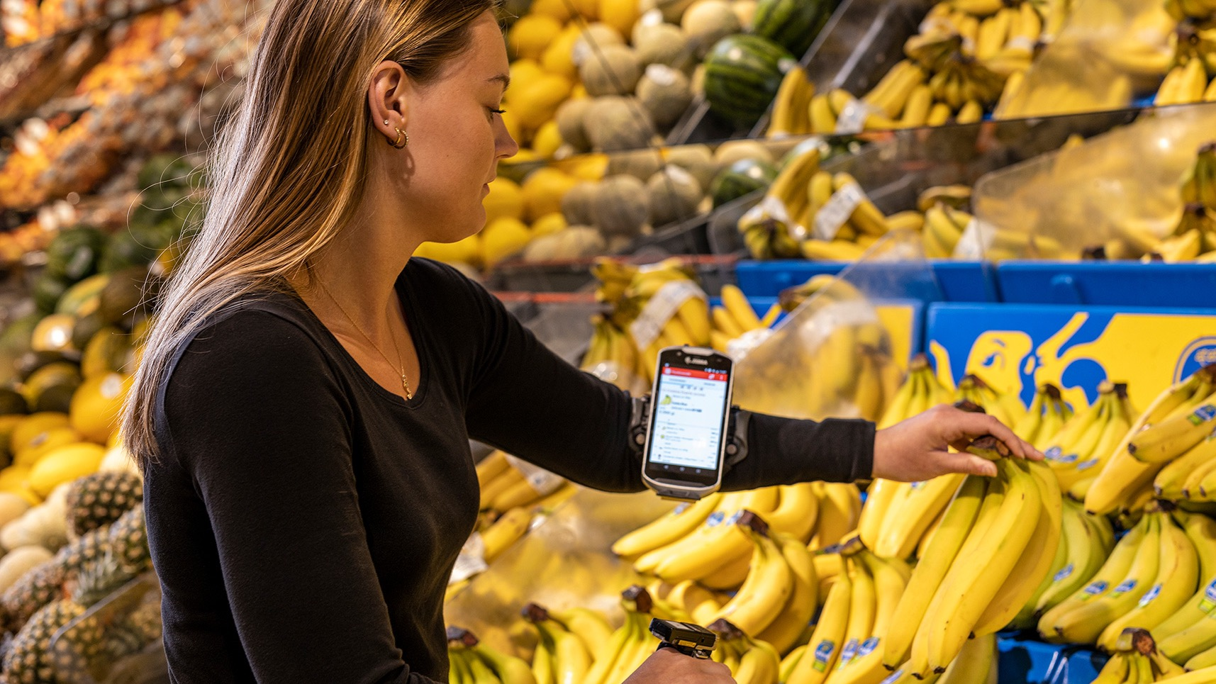
Deep dive on
Scandinavia, UK and Spain

Slide 28




Deep dive on selected core markets
Scandinavia
UK
Spain

Slide 29
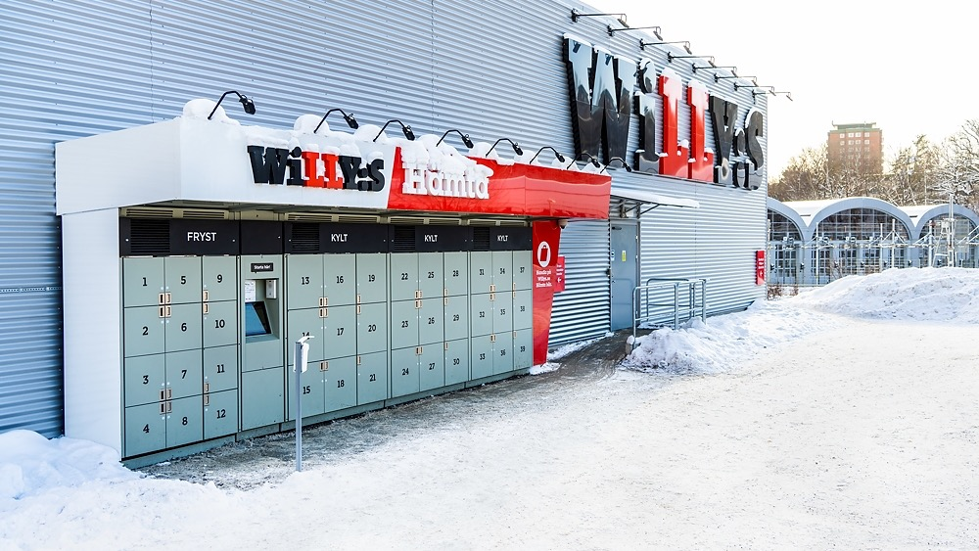
Scandinavia

Slide 30







Decades of grocery customer trust
StrongPoint currently serves all the grocery retailers in
Norway and Sweden representing amazing starting point
Took us 30+ years to get there, and
are now a solid and trusted supplier
4.7
average number
of solutions
used
Position as trusted supplier
= long-term prospects remain strong
Scandinavia
Notes:
Serve all the grocery retailers in Norway & Sweden → amazing starting point
Took us 30+ years to get there but we are a solid and trusted supplier (hence, the 4.7 solutions on average to top 10 grocery customers)
Position as trusted supplier → long-term prospects remain strong

Slide 31
Transformational actions
Organisational efficiency:
One SVP for Norway and Sweden
More synergy effects
More best practice sharing
Commercial steps:
Pricing measures
Harder sales targets and incentives
More targeted marketing and selective campaigns

Slide 32





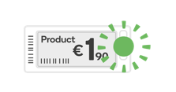

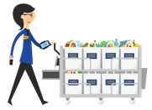

Commercial overview of Scandinavia
Highly penetrated solutions
Less penetrated solutions
Solutions that have yet to be adopted
Experimenting with
new solutions
CashGuard
Autonomous stores
Self-
Checkout
Vensafe
Electronic Shelf Labels
Fraud detection
Micro-Fulfillment
Grocery Lockers
Order Picking
Store operations management
E-Commerce in general in Norway
Scales
Electronic Shelf Labels
Notes:
MFC market potential should be 100 + 80 = 180 MSEK for 2024-2026
SCO market potential should be 15 + 15 = 30 MSEK for 2024-2026
Not sure what we e-commerce means for Norway. Order picking and lockers? If so, only 5 MSEK estimated

Slide 33
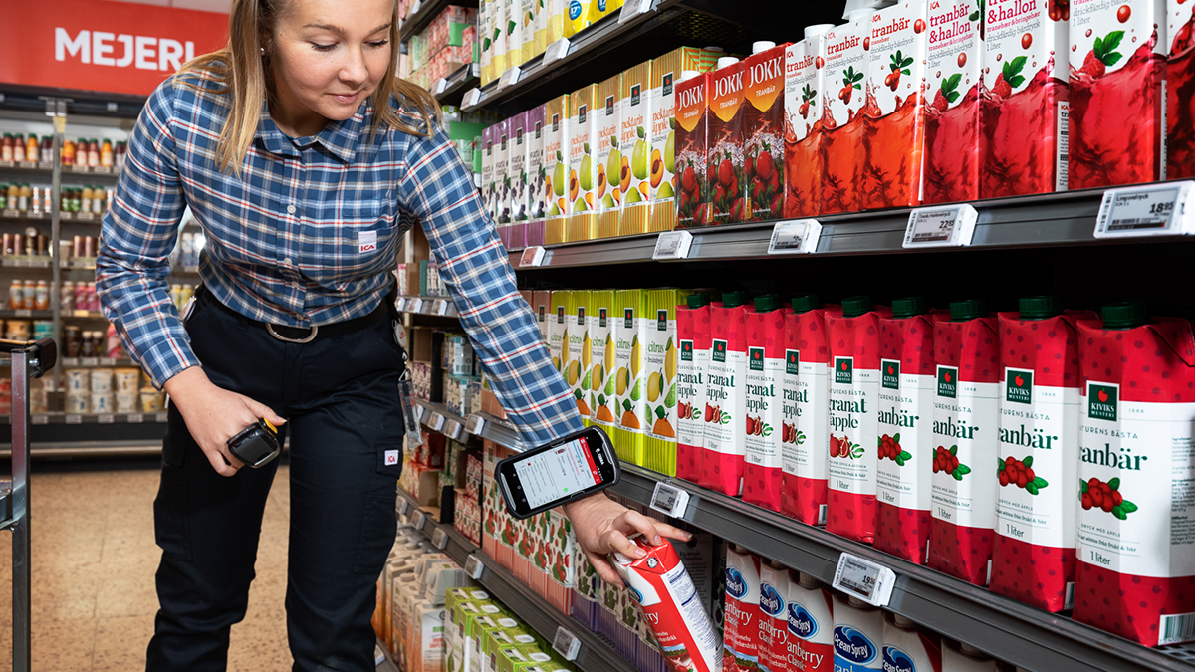
UK

Slide 34
Introduction to StrongPoint ALS UK
StrongPoint invested in the UK and Ireland with acquisition of Air link Group Ltd (ALS) in June 2022
ALS served largest UK and Irish grocery retailers for 25+ years
Building a total retail solution provider on top of existing shopfitting business
ALS pedigree combined with StrongPoint products and solutions, Sainsbury’s win is recent example
Full sales, installation, service & support team
UK
Notes:
Bumpy ride as JT alludes to
Moving forward and key principles still in place:
Heritage and history
Strong foundations
Excellent launchpad for strongpoint products
Expanded revenue opportunities through ability to distribute, install, service and maintain

Slide 35
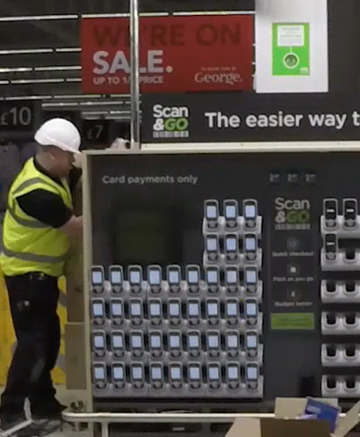
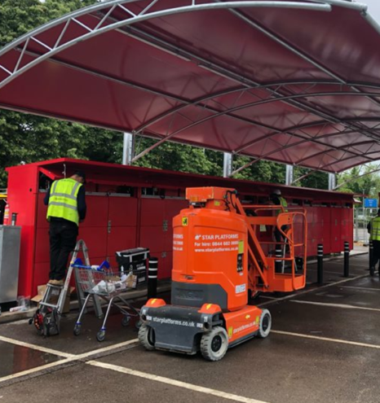
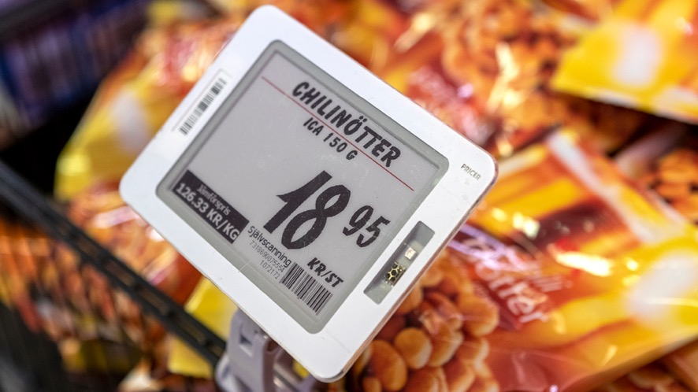
UK priorities
1
2
Bolster shopfitting business and expand customer base
Penetrate UK market with StrongPoint solutions that have good product market fit
Notes:
Flag to Alex “bolster” – ask if he has any other good ideas.
Strong network of contacts and good track record until recent times.
Laser focus on improved delivery and quality in execution
Strengthen existing relationships, expand our reach and grow customer base from a position of strength.
Targeted sales approach
Right Custome, Right Product, Right time (aligning sales, budget and existing contract timings)

Slide 36






UK trends continue to drive opportunities
UK facing challenges,
some already overcome by Scandinavian retailers:
Labour costs increasing
Labour scarcity
Inflation means frequent
price changes/promotions
Rising theft and retail crime
Driving opportunities
Notes:
UK national minimum wage increases 9.8% April 24
Asda announced 8.4% hourly rate increase (£150m p.a)
Sainsburys aiming to remove £1B of cost
UK retail theft estimated at £7.9B in 2023
32% increase from 2022
1.3k daily reported incidents of theft & violence

Slide 37



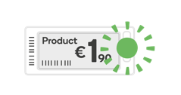
Market opportunities: UK
Vensafe
Micro Fulfillment
Grocery Lockers
Electronic Shelf Labels
Self-
Checkout
Order
Picking
Market
Insights
Entirely untapped market in the UK. No other solution exists quite like it on the market, yet theft continue to soar
Latent demand for automation in UK, market conditions have delayed investment decisions
Many grocery retailers have
tested lockers
in the past and now faced with last mile cost increases
Many grocery retailers testing solution as business case improves with labour costs rising
Used by almost all grocery retailers, many coming to end of life-cycles and looking for next generation solutions
Currently
e-commerce is
12% in UK, all players except
ALDI and LIDL
already have
order picking
in place
Solution Penetration
0%
10%
5%
30%
100%
80%
Opportunity Likelihood
HIGH
HIGH
HIGH
MID
MID
MID
Notes:
Order picking – everyone but the discounters. Sainsburys is a huge strategic win but it won't be the last. Fear of missing out
SCO – Everyone has tried it, is aware of it and has existing contracts. Align our sales strategy to contract expiries and continue to push for hardware, install and service revenue.
Vensafe – Entirely untapped market in the UK. Slightly different way of shopping but can also increase merchandising standards, reduce sales friction and improve customer journey
ESL – market is about to tip and improved business case of Pick – by – light is really compelling to grocers who've struggled to scale any solution
MFC – Takes a large strategic shift and higher investment but can be the fastest route to the most profitable online grocery proposition
Lockers – False start in the UK with poor location strategy and under developed technology. Legislation changes would be a gamechanger but the most convenient, cost effective operating model in Click & Collect

Slide 38
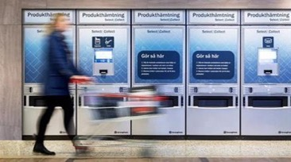
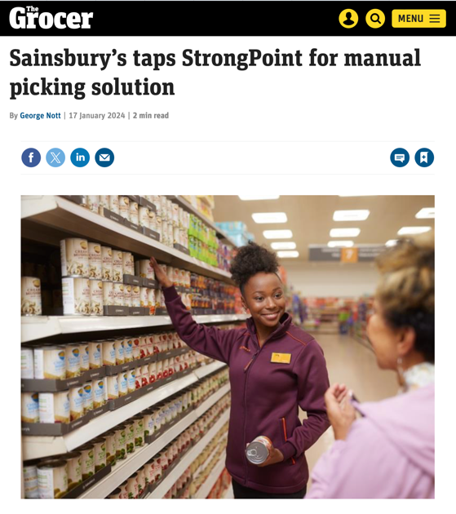
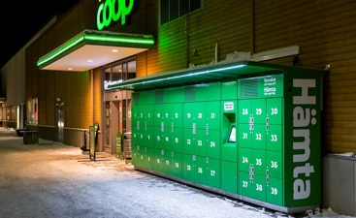
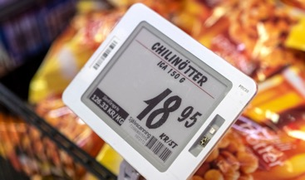
Sainsbury’s picked StrongPoint
Contract signed Q1 2024
Potential additional StrongPoint solutions
Vensafe
Grocery Lockers
Electronic Shelf Labels
Notes:
Account growth is easier if we are doing a good job.
Initial focus on high quality delivery of order picking
Move forwarded complimentary solutions and advance conversations cross functionally
Demonstrate economies of scale as we move to 4.7 solutions with Sainsburys
Foster a partnership relationship to remain as a supplier of choice

Slide 39
Spain

Slide 40



Increasing focus on grocery retail
Today, majority of business is serving non-grocery retailers
Only ~15% of StrongPoint Spain’s revenue comes from grocery retailers
Successes:
We have been successful in a number of retailers with our 4.7 strategy and are starting with a first solution to more than 5 new grocery retailers from a list of approx. 50
Breakthrough grocery success as a door opener
Spain
Notes:
Today, only the 15% of our business in Spain comes from Grocery retailers.
We have been successful with our 4.7 strategy with customers like Alimerka or TuSuper where we have already sold 4 and 5 of our solutions respectively.
BUT, most of our business is still related to CashGuard for HORECA sector.
This is changing, for the last 3 years we have been able to sell a first solution up to 5 new grocery retailers, and we are piloting some of our solutions into another 5, from a list of around 50 grocery retailers in Spain.
Mercadona will be our door opener as certainly we will have lot of potential only for Cash Management to other grocery retailers.
The sign of trust by serving the biggest grocery retailer means that any concern about us being "new" is gone and therefore we will be completely focus on grocery retail growth.

Slide 41

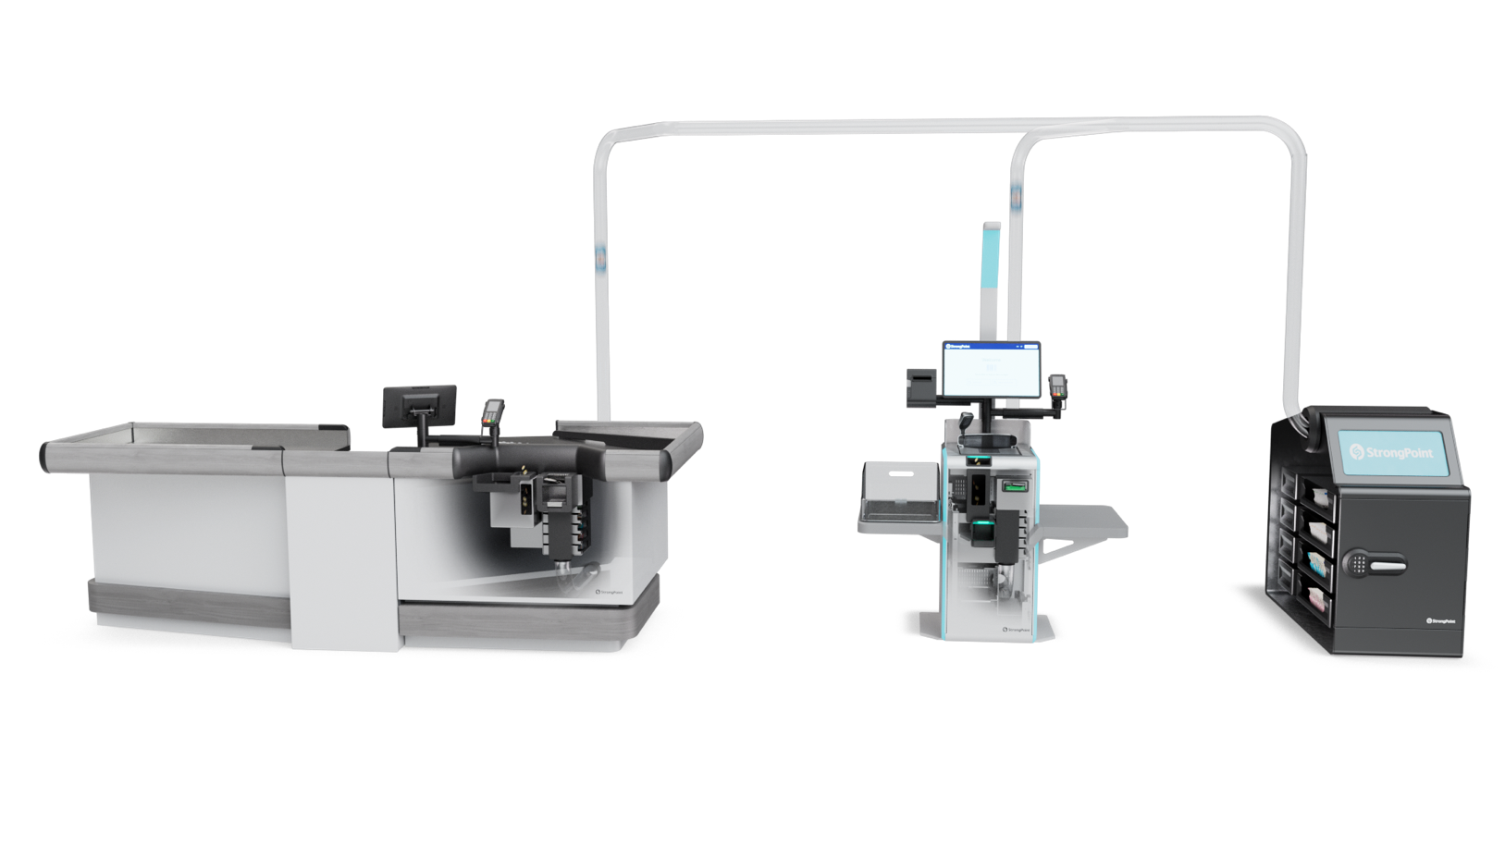
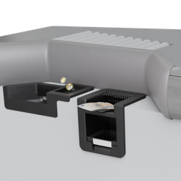
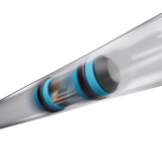
CashGuard Connect
World’s first end-to-end cash automation solution
from customer to cash-in-transit pickup with zero staff intervention at checkout or back office
Cash automatically sent to back office via legacy pneumatic tube systems
Notes are counted, checked and flattened. Cash-in-transit partner alerted when pickup is needed
Customers deposit cash into the built-in coin and note feeders at either staffed or self-service checkouts
Notes:
Note to Lorena: Start with… faster and easier for staffed checkouts… then you can connect Self-Checkout. What you did NOT see is in the back office…
This is how the solutions are connected
We have achieved to develop exactly the vision of Mercadona’s president: to send from customer’s hands all the cash through the existing pneumatic tube systems to an automated safe in the back-office area, thanks to a blister that flies through the tubes automatically when a certain quantity of money is reached.
After 3 years of development with a constant follow-up from the client we have achieved a very important first milestone where we have been able to confirm: the positive reactions from all the employees and management
and even more important the customer or Boss (how they call them) feedback which has been massively positive.
This is going to be an absolute success to Mercadona and other grocery retailers, I am sure.
We control the IP by having exclusive and perpetual rights to sell the solution to all the relevant segments for StronPoint.
Also, the agreement with our partner allows us to acquire the remaining 40% of the Joint Venture society at a fixed defined price.
In the future, we will be able to easily integrate our CashGuard Connect into self-checkout systems, offering again a unique solution to the market.

Slide 42
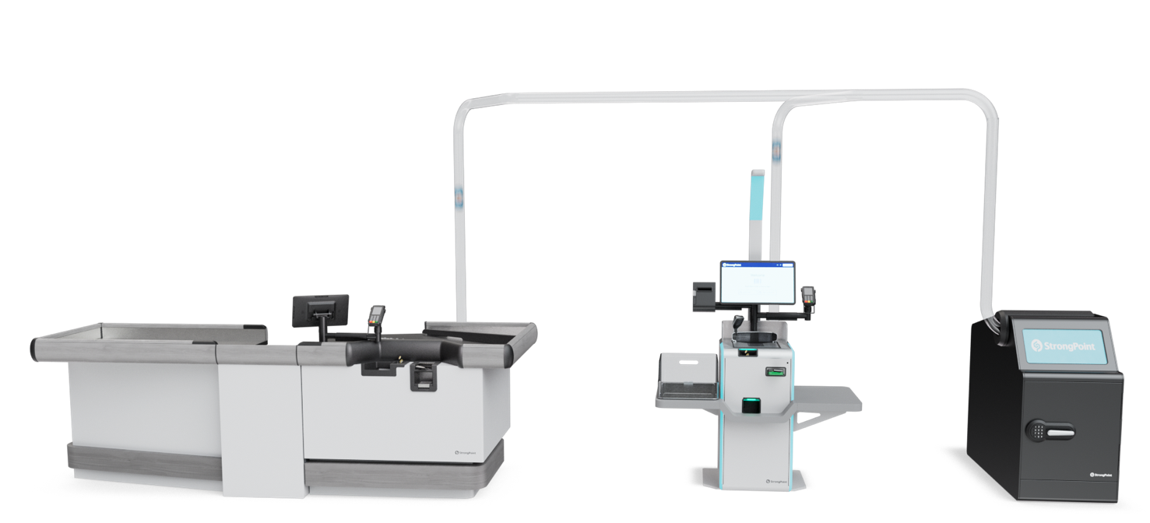
CashGuard Connect: Purpose built for grocery retail
Massively
reduces costs
of processing
cash
+ Makes cash transactions easier and safer for customers and store staff
Notes:
Benefits are very wide:
The total cost of managing cash is hugely optimized as we are achieving zero manual touch points for staff and the number of pickups from the cash in transit company is reduced.
On top, transactions are much faster improving not only the customer experience but optimizing the total staff dedicated to this process.
Handling cash is now as easy as handling card payments from employees. Now they have time to better assist the customers and even start bagging their goods
Finally, the whole process is safer, as nobody will have access to cash anymore.

Slide 43


Market opportunity for CashGuard Connect
Spain €1/4BN
Europe €2BN
First installation in-store. Plans for industrialised production underway with first output expected H2 2025
5+ grocery retailers have relevant infrastructure: pneumatic tube system
Many European grocery retailers use similar pneumatic tube systems (ALS = Air Link System)
Notes:
Flag for retail. Lorena: we control the IP for
Our market opportunity for CashGuard Connect is huge:
Only with Mercadona we expect a significant revenue,
When adding around 5 other grocery retailers in Spain who already have pneumatic tube infrastructure, we would be reaching a quarter of a billion euros
And, if we look at the whole potential in Europe our estimations go far beyond 2 Billion euros.

Slide 44

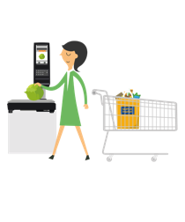
Market opportunities: Spain
Cash Management
Self-
Checkout
Electronic Shelf Labels
Scales
Grocery Lockers
Order
Picking
Market
Insights
Mostly manual cash handling in grocery stores
Most of tier 1
have deployed
and many tier 2 players are now testing the
concept
Grocery retailers testing and deploying ESLs yet few mass rollouts
Most grocery retailers have scales however many are considering for
next generation solution with AI capabilities
Grocery e-commerce penetration is low. Grew 20% in 2023 and expected to continue to grow, driving interest in grocery lockers
With e-commerce growth order picking solutions demand increases
Solution Penetration
5%
25%
10%
100%
25%
25%
Opportunity Likelihood
HIGH
HIGH
HIGH
MID
HIGH
HIGH
Notes:
If we analyze our products market fit in Spain, the best solutions are:
Cash management: only 1 grocery retailer in Spain has really deployed in all the stores a cash management solution in Spain, Alimerka. There is a white space and huge potential
Self-checkout: around 12 retailers have deployed (most of Tier1), and more than 3 other Tier2 retailers are testing now. Huge potential for both mature clients renovating equipment and all Tier2 and Tier3.
ESL: 9 retailers are deploying and above 5 are testing. White space and huge potential
Scales: most of grocery retailers have scales but many of them have transferred the weighing process to the cashiers. There is a big potential when offering scales with AI as is something completely new in the market only tested by a couple of retailers.
Click&Collect lockers: grocery etail e-commerce penetration in Spain is around 2% but some of the players are experimenting growth of above 20% last year so, we expect to grow with our clients growth.
Order picking: same than lockers. I foresee more potential for lockers than for picking.

Slide 45
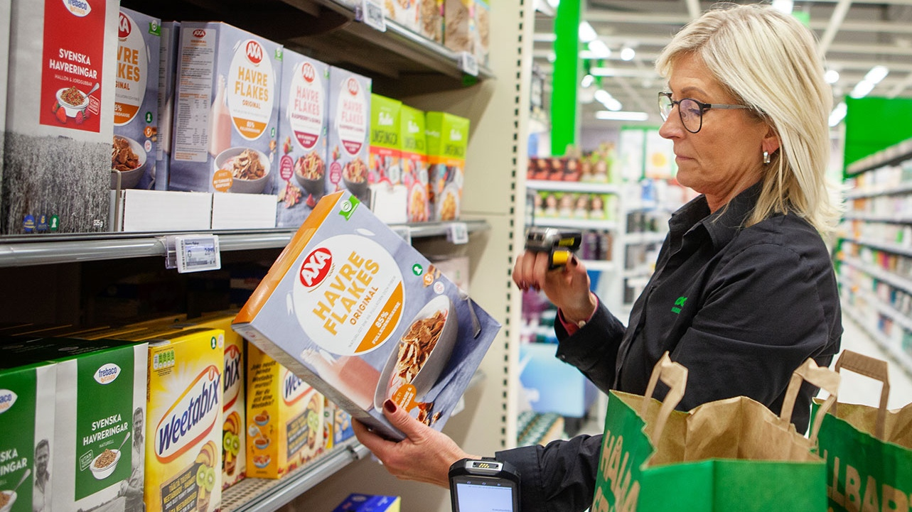
Financial update
Notes:
Thank you very much, Lorena.

Slide 46
Where we are today and our 2025 estimates
2023 Results
2025 Estimate
1.35Bn
1.5-1.8Bn
Revenue
NOK
NOK
0%
4-6%
EBITDA
Notes:
So as Jacob showed us earlier today, we are looking at a revenue estimate of 1.5 to 1.8bn for 2025. This is big range, with only 1.5 years left. Why is this?
1: we still have challenging economic conditions, in all markets. It’s currently not possible for us to say when it will improve.
2: as a product and project-oriented organization, we have limited visibility on future revenues.
Yes we do have recurring revenue from support and licenses, but we have limited impact on the volume and rollout pace of our customers.
However, what history has shown us, is when market conditions improve, product sale can increase quite quickly, partly to a catch-up of previous delays.
To elaborate further on this and the assumption behind the 2025 estimates, I will go deeper into our two reporting segments; Scandinavia and International.

Slide 47
2025 estimates: Scandinavia
Revenue and EBITDA margin
(MNOK)
Overall challenging market conditions in 2023 and so far in 2024
Norway: Increase in in-store deliveries, off-set by expected reduction in payment solutions
Sweden: Increase in in-store and checkout
Stable margins, continuous measures to maintain and strengthen through operational excellence
CAGR 1-10%
7-8%
EBITDA
7%
EBITDA
650–750
2023A
2025e
Notes:
If we look at Scandinavia first, we had revenue of 636 million and an EBITDA margin of 7% in 2023. (744m revenue in 2022, 9%)
Still challenging economic conditions.
2025: looking at 650-750m revenue, with 7-8% margin.
Norway: Planning for an increase in in-store (mainly ESL). Off-set by an expected reduction in payment solutions (cashguards)
Sweden: Similarly, increase in in-store (ESL) and checkout (Vensafe)
Autostore projects: could be a kicker in both countries
Most likely looking at stabile margins; we have done measures already. Operational excellence is required.
If we move further on to the International segment,

Slide 48
2025 estimates: International
Revenue and EBITDA margin
MNOK
Mixed performance in 2023
Baltics and Finland: Increase in Checkout, plus recurring revenue from POS/ ERP
Spain: CashGuard Connect rollout anticipated H2 2025
UK: Restore Shopfitting volume, growth in E-commerce
Margin improvement through scalability and operational leverage
CAGR 10-20%
5-8%
EBITDA
-1%
EBITDA
850–1 050
2023A
2025e
Notes:
There was a mixed picture in 2023 with 706 million in revenue and -1% EBITDA margin.
Solid growth in Baltics, included HW deliveries with lower margin. Some growth in Spain whereas decline in UK Shopfitting
2025: Looking at 850million to above 1 billion.
Baltics & Finland: growth in self-checkout
Spain: anticipated rollout of the CashGuard Connect
UK: restore traction in shopfitting, plus growth in e-commerce with order picking and Autostore
If this materializes, we should be able to improve the margins through scalability and operational leverage.
These are some of the key assumptions for the Scandinavian and International segment

Slide 49
2025 estimates: in-store & e-commerce split
Revenue
MNOK
In-store
Increase in ESL projects,
Self-checkout and
CashGuard Connect
E-commerce
Increase in Order Picking, Grocery Lockers and
AutoStore projects
CAGR 5-15%
1 500 – 1 800
200-300
25-50%
CAGR
E-commerce
1 342
3-10%
CAGR
1 300–1 500
1 216
In-Store
2023A
2025e
Notes:
Another way of looking at our company is through the product portfolio, with in-store products and e-commerce solutions
For in-store, we are anticipating a revenue growth of 3-10%, reaching 1.3 to 1.5bn in 2025.
This is driven by ESL projects, self-checkout growth and the rollout of CashGuard Connect. As I mentioned for the Scandinavian segment, this growth is partly offset by a reduction in CashGuard
For e-com, we are assuming a revenue growth rate of 25-50% from today’s level, reaching 200 to 300 million in revenue.
We have certain visibility on the Order Picking revenue stream from the Sainsbury’s contract, but keep in mind this is recurring revenue periodized over several years
This also includes an increase in Grocery Lockers and Autostore projects.
Now let’s move on where we are on M&A

Slide 50
M&A update
Integration of completed acquisitions
M&A activities and looking ahead
StrongPoint ALS (UK and Ireland) – June 2022
Revenue of MNOK 283 in 2023
Stand-alone first year (Shopfitting)
Integration completed ~summer 2024 with new leadership team
Expanded offerings, e.g. ESL, Vensafe, Order Picking
StrongPoint Hamari (Finland) – October 2023
Revenue of MNOK 14 in 2023
Operating stand-alone, but included in the Baltics region, focusing on commercial synergies
Short-term focus on improving current operations
M&A could be important lever going forward at the right time and in the right conditions
Complementary solutions which could add to our current offering and strengthen our USP
Notes:
First of all, if we look at the initial 2025 strategy, M&A was a part of reaching the ambition of 2.5bn in revenue
During the last years, we have made two acquisitions; one in the UK in 2022 and one in Finland last year. Made to made to get regional footprint and infrastructure – not revenue driven.
We were patient and could have done more M&A, especially in 2020 and 2021 where the M&A volume was high, particularly within SaaS companies. But with high valuation multiples.
As far as the ALS acquisition, Jacob and Alex have provided a good update. It’s fair to say that we haven’t yielded what we wanted – yet. But is still early.
We have completed the internal integration to improve the collaboration and now working to expand our product offering beyond the shopfitting revenue stream.
Hamari: closed end of last year. Operating fairly stand-alone still, but being a part of the Baltic region, where the main focus is on commercial opportunities.
Looking ahead: short term focus is to improve the current operations.
But: We have an opportunistic approach and we are continuously being approached with potential targets. So at the right conditions, we are interested in strengthening our offerings.

Slide 51
Financing update
Net interest-bearing debt and IFRS 16 lease obligations (MNOK)
Increase of (not interest-bearing) lease obligations in 2023 due to new premises in Norway
Gone from almost zero interest bearing debt to debt situation
Secured new financing better suited to our growth ambitions in UK and Spain with bigger, more demanding customers
Equity ratio covenant of 30%
Solid balance sheet with 46% equity ratio
87
77
3
2022A
2023A
Q1 2024A
IFRS 16 Leases (not interest-bearing)
Net interest-bearing debt
Notes:
Moving over to financing and other obligations.
Our leasing obligations increased from 2022 to 2023 because we moved into new premises in Norway. Keep in mind that these lease obligations are not interest-bearing.
The interest-bearing debt, however, has increased from zero in 2022 to now 80 million. This is due to lower operational performance, continued investments and a dividend payment last year.
As we talked about earlier this morning in our quarterly presentation, we have signed an agreement with a leading Scandinavian financial institution to refinance our bank overdraft.
This will make us better suited for growing with our international, more demanding customers
Also, with our current financing, there is a net leverage covenant, which will not be required in this new financing.
There will be a 30% equity ratio covenant. As of now, we have 46% and a solid balance sheet.

Slide 52
Strong history of dividend payment
Dividend
NOK per share
Policy continues to be to pay dividend and increase
No dividend for 2023
Focus on managing debt
1.50
Extraordinary dividend
1.00
0.90
0.80
0.70
0.55
0.60
0.45
0.50
0.30
0.35
0.25
0.50
Notes:
Finally, on the financial update, we have had a strong history of dividend payments
And this policy continues, this is clearly our ambition going forward.
For 2023, however, it was not possible to pay out any dividends.
The focus now, as we have touched upon several times, to improve operations, continue our strategic investments and while doing this, managing the debt levels.

Slide 53
Concluding comments

Slide 54





StrongPoint 2020 vs. 2024
StrongPoint before new strategy released
StrongPoint in 2024
3 business areas, 16 offices incl. Russia and Malaysia
Grocery retail tech focused with 9 priority countries
Mainly selling hardware with some service agreements
Solution sales with high potential for additional recurring software income and professional services
Organization with competence to serve retailers in general with legacy products
Developed staff to serve grocery retailers with expanded portfolio of solutions
Serving leading Scandinavian and Baltic
retailers only
Started serving the very top tier-1 European grocery retailer clients
Dependent on a few large customers in 2-3 countries
Platform for reduced risk profile: wider customer base across 9 priority countries
Notes:
When looking at our financial results – which clearly are currently not where we want them to be – it is easy to think that StrongPoint has gone backward, not forward. So allow me to take a step back and reflect a bit at the larger picture on how StrongPoint is now positioned vs. 4 years ago when our new strategy was unveiled

Slide 55
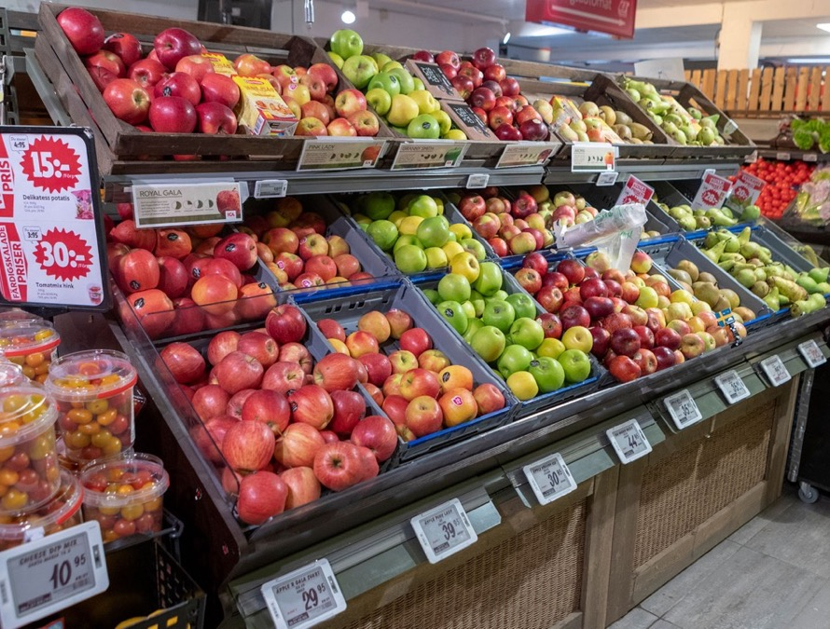


Challenges and opportunities
Facing multiple challenges and working to overcome them: reduced costs, transformation program incl. operations and products
Lots of opportunities in traditional and future key markets: and our investments are now starting to bear fruit
Notes:
-That (previous page) was a longer-term look at recent history
-Now, today we have both immediate challenges and opportunities that needs to be tackled and nurtured…
-Tackling and nurturing these challenges and opportunities in today’s uncertain market will bring us to the financial estimates showed earlier: clearly 1.5-1.8 bn revenue and 4-6% EBITDA is not where we aspire to be. As our large opportunities will only materialize in parts of 2025, and market sentiment is highly uncertain in the quarters and perhaps year to come, we also want to share our long-term financial ambitions for StrongPoint..

Slide 56


Long-term financial aspirations
Revenue
growth
EBITDA
>10%
Continue to pay and increase the dividend forward

Slide 57






Key priorities
Transform traditional core markets of Norway, Sweden and further grow Baltics and Finland
Build on initial success for large-scale operations in UK and Spain
Notes:
Rounding off with key priorities

Slide 58

Q&A

Slide 59


Thank you
StrongPoint
www.strongpoint.com
Slynga 10 2005 Rælingen, Norway
**************************************************
**************************************************
Thank you for shopping with StrongPoint

